Slide 1

Chapter 11 Artificial Neural Networks Part 1

Slide 2
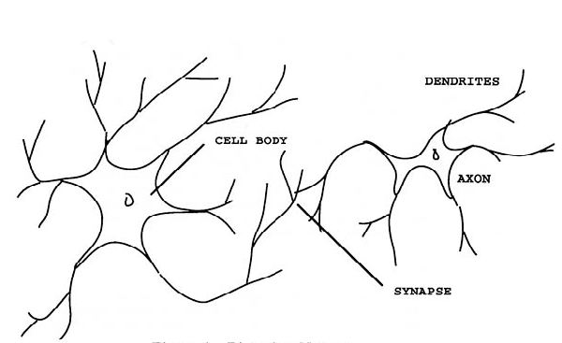
Outline
Biological Neural Networks
Artificial Neuron
Perceptron Learning
Backpropagation Learning
Neural Networks Applications

Slide 3
Introduction to ANN
An artificial neural network (ann) is a system formed by interconnecting a number of trivially simple computing devices in a network in order to solve pattern recognition problems without explicit programming.
Pattern recognition is the process of classifying input data into objects or classes based on key features.
Also called neural networks (nn), connectionist computing, parallel distributed processing.
Neural network learning algorithms:
Perceptron single layer of training examples
Backpropagation multi layer of training examples

Slide 4
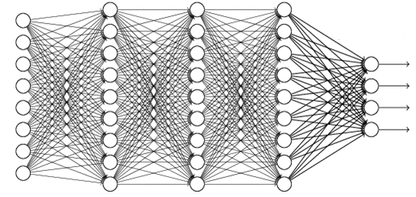
Artificial Neuron
An artificial neural network is modeled as a graph with neuron cells as nodes and synaptic connections as weighted edges.
The basis of neural networks is the artificial neuron.

Slide 5
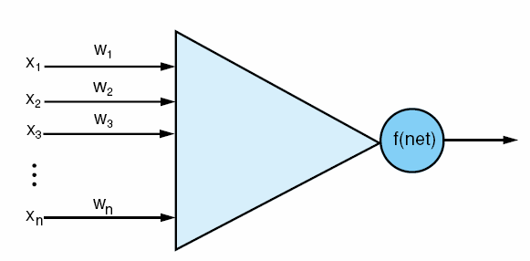
An artificial neuron, input vector x_{i}, weights on each input line, and a threshold function f that determines the neuron’s output value.
2

Slide 6
An artificial neuron consists of
Input signals (x₁, x₂, … x_{n}): could come from the environment, or the activation of other neurons. Input values could be from {0, 1}, or real numbers.
A set of real valued weights (w₁, w₂, … w_{n}): describe connection strengths.
An activation level
Determined by the cumulative strength of its input signals where each input signal is scaled by its connection weight along that input line.
A threshold function f: computes the neuron’s output by determining how far the neuron’s activation level is below or above some threshold value (t).
Output
1
0
t
net

Slide 7
Artificial Neuron
Examples: simulate logic gates
AND: Let each weight be threshold/n, where n is the number of inputs.
OR: Let each weight be threshold.
NOT: Let threshold be 0, single input with a negative weight.

Slide 8
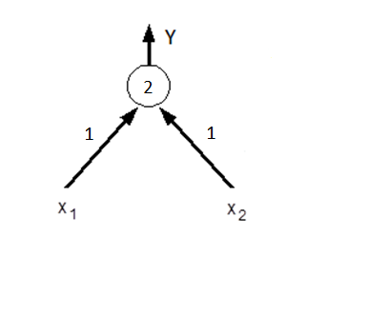
Example: A neuron computes the AND function
x₁ | x₂ | Y
0 | 0 | 0
0 | 1 | 0
1 | 0 | 0
1 | 1 | 1
INPUT: x₁ = 0, x₂ = 0
1*0 + 1*0 = 0 < 2 ➔ OUTPUT: 0
INPUT: x₁ = 0, x₂ = 1
1*0 + 1*1 = 1 < 2 ➔ OUTPUT: 0
INPUT: x₁ = 1, x₂ = 0
1*1 + 1*0 = 1 < 2 ➔ OUTPUT: 0
INPUT: x₁ = 1, x₂ = 1
1*1 + 1*1 = 2 >= 2 ➔ OUTPUT: 1
w1 = 1, w2 = 1
threshold = 2

Slide 9
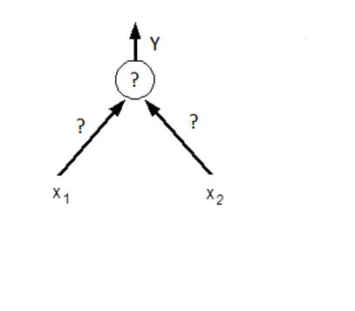
Exercise: A neuron computes the OR function
x₁ | x₂ | Y
0 | 0 | 0
0 | 1 | 1
1 | 0 | 1
1 | 1 | 1
INPUT: x₁ = 0, x₂ = 0
w₁*0 + w₂*0 < t ➔ OUTPUT: 0
INPUT: x₁ = 0, x₂ = 1
w₁*0 + w₂*1 >= t ➔ OUTPUT: 1
INPUT: x₁ = 1, x₂ = 0
w₁*1 + w₂*0 >= t ➔ OUTPUT: 1
INPUT: x₁ = 1, x₂ = 1
w₁*1 + w₂*1 >= t ➔ OUTPUT: 1
w1 = ?, w2 = ?
threshold = ?

Slide 10
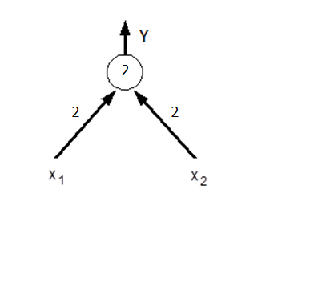
Answer: A neuron computes the OR function
x₁ | x₂ | Y
0 | 0 | 0
0 | 1 | 1
1 | 0 | 1
1 | 1 | 1
INPUT: x₁ = 0, x₂ = 0
2*0 + 2*0 < 2 ➔ OUTPUT: 0
INPUT: x₁ = 0, x₂ = 1
2*0 + 2*1 >= 2 ➔ OUTPUT: 1
INPUT: x₁ = 1, x₂ = 0
2*1 + 2*0 >= 2 ➔ OUTPUT: 1
INPUT: x₁ = 1, x₂ = 1
2*1 + 2*1 >= 2 ➔ OUTPUT: 1
w1 = 2, w2 = 2
threshold = 2

Slide 11
Another exercise: A neuron computes the XOR function
x₁ | x₂ | Y
0 | 0 | 0
0 | 1 | 1
1 | 0 | 1
1 | 1 | 0
INPUT: x₁ = 0, x₂ = 0
w₁*0 + w₂*0 < t ➔ OUTPUT: 0
INPUT: x₁ = 0, x₂ = 1
w₁*0 + w₂*1 >= t ➔ OUTPUT: 1
INPUT: x₁ = 1, x₂ = 0
w₁*1 + w₂*0 >= t ➔ OUTPUT: 1
INPUT: x₁ = 1, x₂ = 1
w₁*1 + w₂*1 < t ➔ OUTPUT: 0
w1 = ?, w2 = ?
threshold = ?

Slide 12
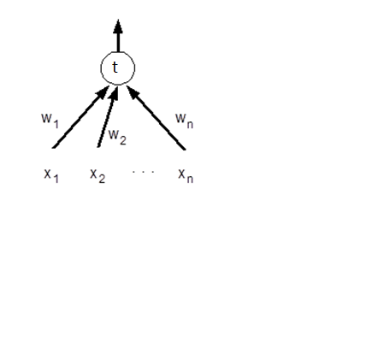
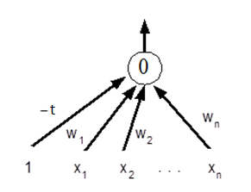
Normalizing Thresholds
To make neurons more uniform, we can normalize thresholds to 0 for all neurons.
Simply add an additional input x₀ = 1, w₀ = -t
Σw_{i}x_{i} >= t ≡ -t*1 + Σw_{i}x_{i} >= 0

Slide 13
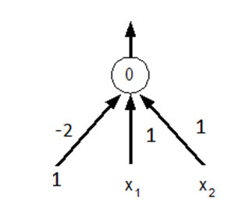
Normalized Example
AND
INPUT: x₁ = 0, x₂ = 0
-2*1 +1*0 + 1*0 = -2 < 0 ➔ OUTPUT: 0
INPUT: x₁ = 0, x₂ = 1
-2*1 +1*0 + 1*1 = -1 < 0 ➔ OUTPUT: 0
INPUT: x₁ = 1, x₂ = 0
-2*1 +1*1 + 1*0 = -1 < 0 ➔ OUTPUT: 0
INPUT: x₁ = 1, x₂ = 1
-2*1 + 1*1 + 1*1 = 0>= 0 ➔ OUTPUT: 1

Slide 14
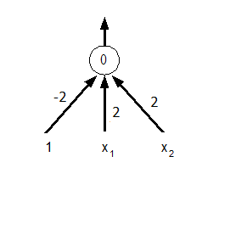
Normalized Example
OR
INPUT: x₁ = 0, x₂ = 0
-2*1 +2*0 + 2*0 = -2 < 0 ➔ OUTPUT: 0
INPUT: x₁ = 0, x₂ = 1
-2*1 +2*0 + 2*1 = 0 >= 0 ➔ OUTPUT: 1
INPUT: x₁ = 1, x₂ = 0
-2*1 +2*1 + 2*0 = 0 >= 0 ➔ OUTPUT: 1
INPUT: x₁ = 1, x₂ = 1
-2* 1+ 2*1 + 2*1 = 2 >= 0 ➔ OUTPUT: 1

Slide 15

Perceptron感知 Learning
The perceptron is also called binary classifier which maps its input x (a Boolean or real-valued vector) to an output value f(x) (a single binary value):
where x₀ (called bias) has a constant value of 1, x₁ …. x_{n} are inputs
The value of f(x) (1 or 0) is used to classify x as either a positive or a negative instance.

Slide 16
Perceptron Learning
Basic idea:
Start with a training set (example inputs & corresponding desired outputs).
Train the network to recognize the examples in the training set (by adjusting the weights on the connections).
Once trained, the network can be applied to new instances.
It is supervised learning.

Slide 17
Perceptron Training Algorithm
Begin
Initialize weights to small random values
Repeat
For each training example E, do:
Compute the actual output o for E given its inputs
Compare the actual output with the desired value, d for E
Update weights using the learning rules
Until outputs of all training examples are correct
End

Slide 18
Perceptron Learning Rules
Compare the actual output of the network with the desired outpu.
If the actual output and desired output are equal, do nothing.
If the actual output is lower than the desired output, increment the weight on each line: w_{i} += c * x_{i} (0 <= i <= n).
If the actual output is higher, decrement the weight on each line: w_{i} -= c* x_{i} (0 <= i <= n).
c (0 < c <= 1) is a constant whose size determines the learning rate .

Slide 19
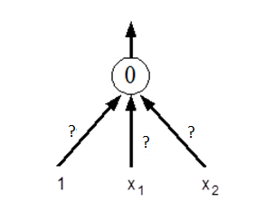
Example
Train a perceptron to compute AND.
Training set:
x₁ | x₂ | Y
0 | 0 | 0
0 | 1 | 0
1 | 0 | 0
1 | 1 | 1

Slide 20
Example
Randomly initialize w₀ = 0.1, w₁=-0.4, w₂=1.2 and let c = 0.5.
Iteration #1 (training example 1):
Sum: w₀x₀ + w₁x₁ + w₂x₂ = 0.1 ( >= 0)
The actual output is higher than the desired output, decrement the weight on each line by the product of its corresponding input and the leaning rate w_{i} -= c * x_{i}
w₀ = w₀ - c * x₀ = 0.1 - 0.5 * 1 = -0.4
w₁ = w₁ - c * x₁ = -0.4 - 0.5 * 0 = -0.4
w₂ = w₂ - c * x₂ = 1.2 - 0.5 * 0 = 1.2
x₀ | x₁ | x₂ | Desired output | w₀ | w₁ | w₂ | Actual output | Equal?
1 | 0 | 0 | 0 | 0.1 | -0.4 | 1.2 | 1 | No

Slide 21
Iteration #1 (training example #2):
x₀ | x₁ | x₂ | Desired output | w₀ | w₁ | w₂ | Actual output | Equal?
1 | 0 | 1 | 0 | -0.4 | -0.4 | 1.2 | 1 | No
Sum: w₀x₀ + w₁x₁ + w₂x₂ = 0.8 ( >= 0)
The actual output is higher than the desired output, decrement the weight on each line w_{i} -= c * x_{i}
w₀ = w₀ - c * x₀ = -0.4 - 0.5 * 1 = -0.9
w₁ = w₁ - c * x₁ = -0.4 - 0.5 * 0 = -0.4
w₂ = w₂ - c * x₂ = 1.2 - 0.5 * 1 = 0.7

Slide 22
Iteration #1 (training example #3):
x₀ | x₁ | x₂ | Desired output | w₀ | w₁ | w₂ | Actual output | Equal?
1 | 1 | 0 | 0 | -0.9 | -0.4 | 0.7 | 0 | Yes
Sum: w₀x₀ + w₁x₁ + w₂x₂ = -1.3 ( < 0)
The actual output and desired output are equal, do nothing.

Slide 23
Iteration #1 (training example #4):
x₀ | x₁ | x₂ | Desired output | w₀ | w₁ | w₂ | Actual output | Equal?
1 | 1 | 1 | 1 | -0.9 | -0.4 | 0.7 | 0 | No
Sum: w₀x₀ + w₁x₁ + w₂x₂ = -0.6 ( <0 )
The actual output is lower than the desired output, increment the weight on each line w_{i} += c * x_{i}
w₀ = w₀ + c * x₀ = -0.9 + 0.5 * 1 = -0.4
w₁ = w₁ + c * x₁ = -0.4 + 0.5 * 1 = 0.1
w₂ = w₂ + c * x₂ = 0.7 + 0.5 * 1 = 1.2

Slide 24
Iteration #2
x₀ | x₁ | x₂ | Desired output | w₀ | w₁ | w₂ | Sum | Actual output | Equal?
1 | 0 | 0 | 0 | -0.4 | 0.1 | 1.2 | -0.4 | 0 | YES
1 | 0 | 1 | 0 | -0.4 | 0.1 | 1.2 | 0.8 | 1 | NO
1 | 1 | 0 | 0 | -0.9 | 0.1 | 0.7 | -0.8 | 0 | YES
1 | 1 | 1 | 1 | -0.9 | 0.1 | 0.7 | -0.1 | 0 | NO

Slide 25
Iteration #3
x₀ | x₁ | x₂ | Desired output | w₀ | w₁ | w₂ | Sum | Actual output | Equal?
1 | 0 | 0 | 0 | -0.4 | 0.6 | 1.2 | -0.4 | 0 | YES
1 | 0 | 1 | 0 | -0.4 | 0.6 | 1.2 | 0.8 | 1 | NO
1 | 1 | 0 | 0 | -0.9 | 0.6 | 0.7 | -0.3 | 0 | YES
1 | 1 | 1 | 1 | -0.9 | 0.6 | 0.7 | 0.4 | 1 | YES

Slide 26
Iteration #4
x₀ | x₁ | x₂ | Desired output | w₀ | w₁ | w₂ | Sum | Actual output | Equal?
1 | 0 | 0 | 0 | -0.9 | 0.6 | 0.7 | -0.9 | 0 | YES
1 | 0 | 1 | 0 | -0.9 | 0.6 | 0.7 | -0.2 | 0 | YES
1 | 1 | 0 | 0 | -0.9 | 0.6 | 0.7 | -0.3 | 0 | YES
1 | 1 | 1 | 1 | -0.9 | 0.6 | 0.7 | 0.4 | 1 | YES
Converged after 4 iterations!

Slide 27
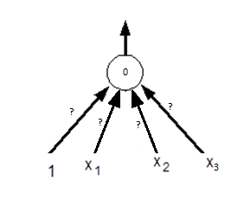
Exercise: Use a perceptron to compute the majority function
Task: Output 1 if at least two of the three inputs are 1.
x₁ | x₂ | x₃ | Y
0 | 0 | 0 | 0
0 | 0 | 1 | 0
0 | 1 | 0 | 0
0 | 1 | 1 | 1
1 | 0 | 0 | 0
1 | 0 | 1 | 1
1 | 1 | 0 | 1
1 | 1 | 1 | 1
Possible weights: w₀ = -0.4, w₁ = 0.3,
w₂ = 0.3, w₃ = 0.3

Slide 28
Convergence
Perceptron Convergence Theorem: The perceptron training algorithm will always converge (find weights) if such a set of weights exists.
Perceptron cycling theorem: If the data is not linearly separable, the perceptron training algorithm will eventually repeat the same sets of weights and therefore enter an infinite loop.

Slide 29
Convergence
Minsky & Papert showed weights exist if and only if the problem (data) is linearly separable.
Consider the case with 2 inputs, x₁ and x₂.
If you can draw a line and separate the accepting (output: 1) & non-accepting (output: 0) examples, then linearly separable.
For n inputs, we must be able to separate with an (n-1)-dimensional plane.

Slide 30
The output depends on w₀ + w₁x₁ + w₂x₂ >= 0
border case is when w₀ + w₁x₁ + w₂x₂ = 0
i.e., x₂ = (-w₁/w₂) x₁ + (-w₀ /w₂) the equation of a line
The training algorithm simply shifts the line around (by changing the weight) until the classes are separated.

Slide 31
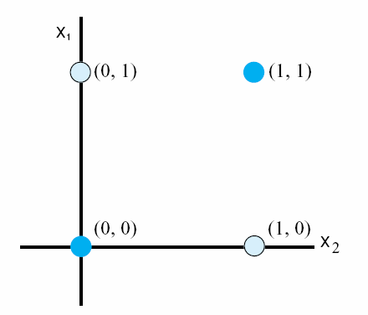
Example: Inadequacy of Perceptrons
The exclusive-or problem: No straight line in two-dimensions can separate the (0, 1) and (1, 0) data points from (0, 0) and (1, 1).

Slide 32
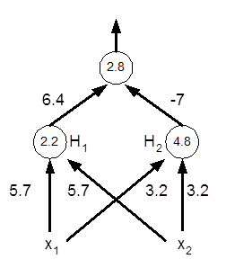
Solution!
However, we can compute XOR by introducing a hidden layer.

